Slide 1

PROFILE
STUDENT NAME : FARAZ A
REGISTER NO & NMID : 35524U09011 &
B75B726242AEBFAAE604C0C8914B79F5
DEPARTMENT : II-BCA
COLLEGE/UNIVERSITY :GOVT ATRS AND SCIENCE COLLEGE
THIRUPATTUR /THIRUVALLUVAR UNIVERSITY

Slide 2

PROJECT TITLE
E-COMMERCE

Slide 3

Problem Statement
Project Overview
End Uers
Tools and Technologies
Portfolio design and layout
Feature and Functionality
Result and screenshots
Conculsion
Github link
AGENDA

Slide 4

PROBLEM STATEMENT
Small and medium businesses struggle to reach a wider audience, while customers find it difficult to compare products, get personalized recommendations, and shop conveniently anytime, anywhere.
Provide a wide range of products from multiple vendors.
Ensure secure payment gateways and data privacy.
Offer user-friendly navigation and personalized recommendations.
Include features like order tracking, product reviews, and quick delivery.

Slide 5
PROJECT OVERVIEW
E-Commerce refers to the online buying and selling of goods and services using digital platforms. The program aims to provide knowledge of e-commerce models (B2B, B2C, C2C, C2B), digital marketing, secure payment systems, logistics, and online store management. Learners gain practical skills in setting up e-commerce websites, integrating payment gateways, and understanding security measures. This program prepares students for careers as e-commerce specialists, digital marketers, business analysts, and web developers in the growing digital economy.

Slide 6
END USERS
Individual Consumers (B2C) – People buying products for personal use (e.g., Amazon, Flipkart). Businesses (B2B) – Companies purchasing in bulk for resale or production (e.g., Alibaba). Government & Institutions – Using e-commerce for procurement and services. C2C Users – Individuals selling directly to other individuals (e.g., OLX, eBay).

Slide 7


TOOLS AND TECHNIQUES
TOOLS
TECHNIQUES
Payment gateways (PayPal, UPI, Stripe) Digital marketing tools (Google Ads, Mailchimp) Analytics tools (Google Analytics) CRM systems (Salesforce, Zoho) Logistics & inventory tools (Shiprocket, Unicommerce)
Search Engine Optimization (SEO) Search Engine Marketing (SEM) Social Media Marketing (SMM) Email marketing campaigns Personalization with AI (recommendation

Slide 8
PORTFOLIO DESIGNS AND LAYOUT
The design and layout of an e-commerce platform play a vital role in attracting and retaining customers. A good design ensures easy navigation, fast loading, mobile responsiveness, and secure checkout. The layout should be clean, visually appealing, and product-focused, with clear categories, search options, and call-to-action buttons. Key elements include homepage banners, product listings with images, shopping cart visibility, and simple payment flow.

Slide 9
FEATURES AND FUNCTIONALITY
E-commerce platforms provide features like product catalogs, search options, shopping carts, secure checkout, multiple payment methods, and order tracking. Advanced functionalities include personalized recommendations, customer reviews, loyalty programs, mobile responsiveness, data analytics, and strong security measures. These elements together enhance user experience, build trust, and drive sales growth.

Slide 10

RESULTS
The "result of e-commerce" is a significant transformation of global commerce, characterized by increased market reach and customer engagement for businesses, alongside greater convenience and choice for consumers. Key results include reduced operational costs for businesses, a faster buying process, expansion into global markets, and the ability to analyze and respond to customer needs more effectively. E-commerce has spurred innovation, driven economic growth, and continues to evolve with advancements like AI, making it a powerful force in the modern economy.

Slide 11

SCREENSHOTS

Slide 12
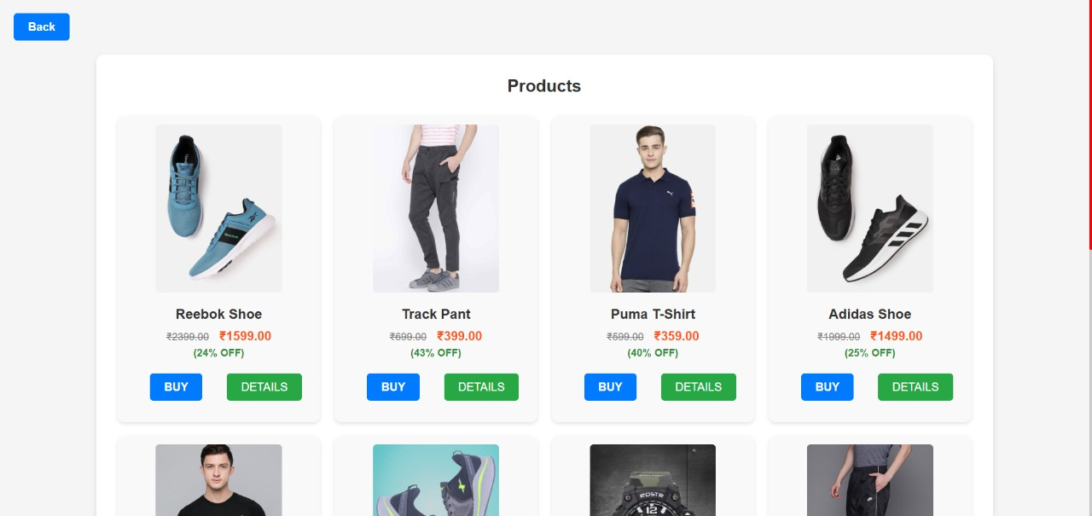
SCREENSHOTS

Slide 13
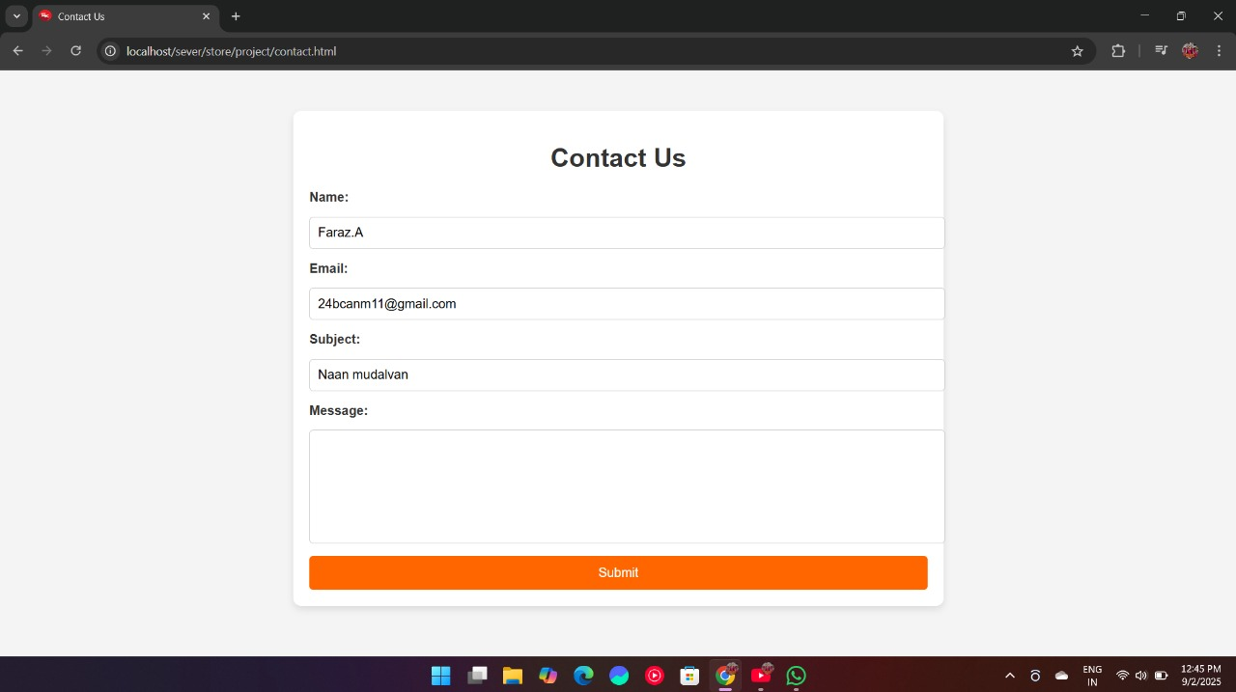
SCREENSHOTS

Slide 14

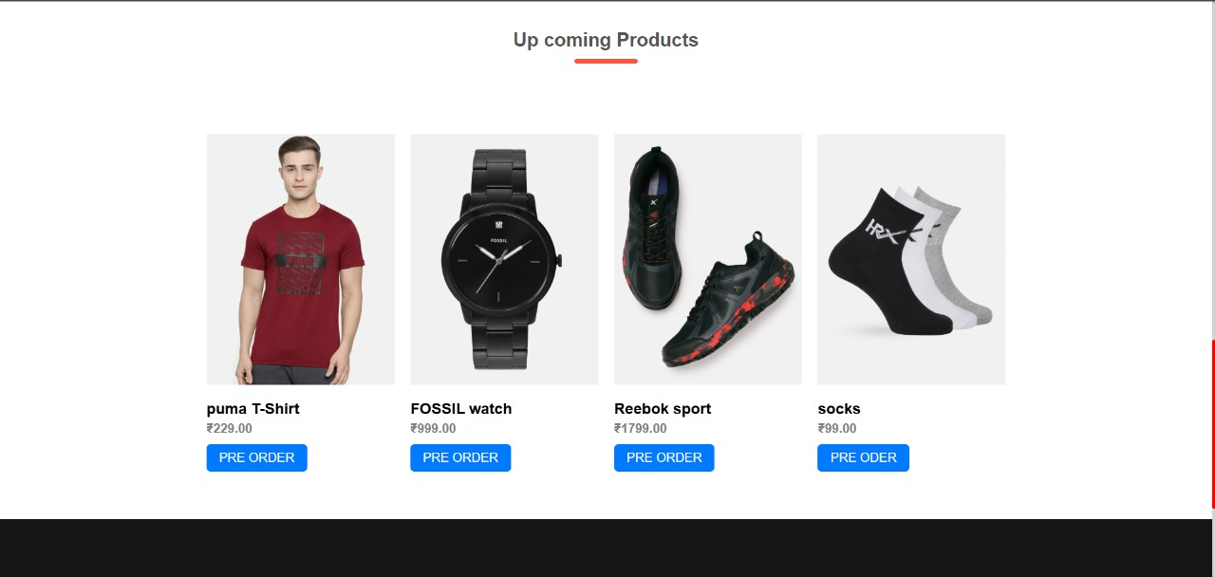
SCREENSHOTS

Slide 15
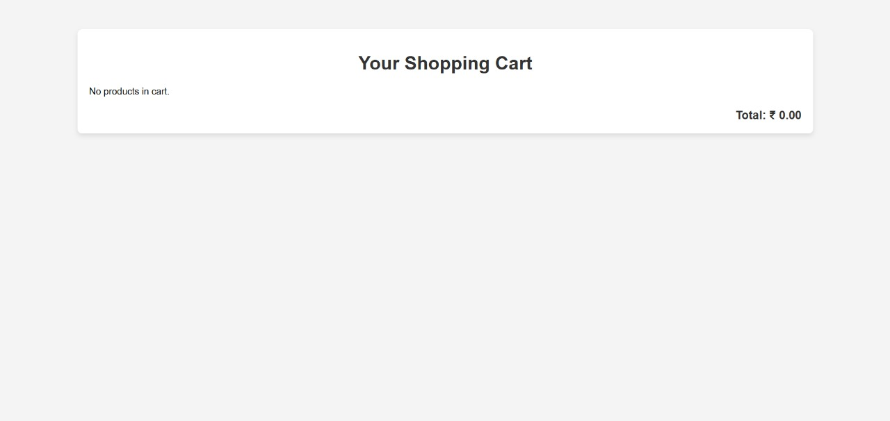
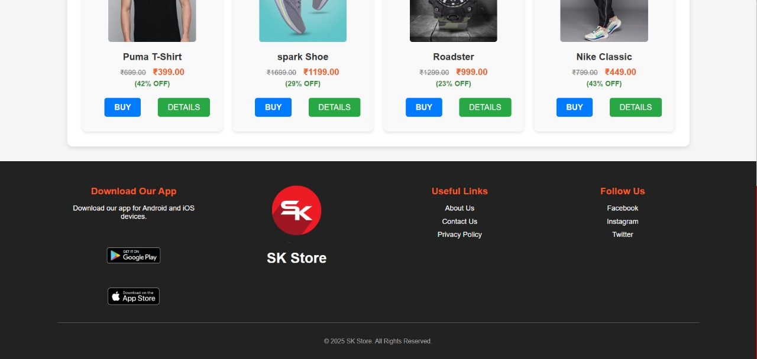
SCREENSHOTS

Slide 16
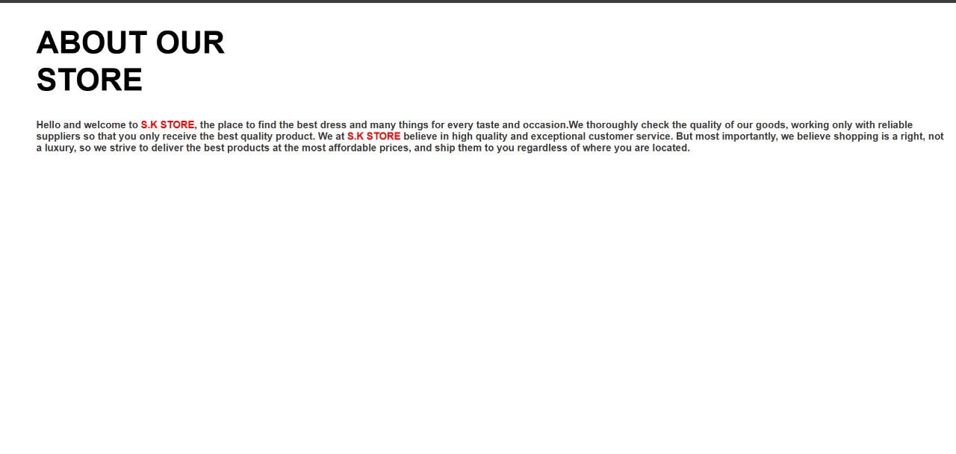
SCREENSHOTS

Slide 17
CONCULSION
The conclusion of e-commerce is that despite inherent challenges like security and infrastructure, its advantages of global reach, cost efficiency, and innovation make it a continually growing and vital force in the global economy. To succeed, businesses must implement robust security, embrace mobile and AI-driven solutions, and adapt to evolving trends while focusing on customer trust and value.
Global Reach and Cost Efficiency.
Technological Innovation.
Customer-Centric Focus.
Market Growth.
Challenge.

Slide 18
GITHUB LINK
https://github.com/faraznm2025/Naan-mudalvan.git

Slide 19
E-COMMERCE
THANK YOU
expressing appreciation in an e-commerce context, using methods like thank you emails, chat messages, or notes included with orders to build trust, encourage repeat business, and foster customer loyalty.

